Slide 2
Absence of Copyright
This slideshow contains photos, diagrams, and information, some of which were attained through internet searches of public websites. The author of this presentation does not own the copyright on this information, so this slideshow is for personal use only—not for sale or profit. Please utilize it to seek the Lord and grow in your knowledge of His Word and ways.

Slide 3
END HERE JUNE 24, 2020
WEEK 7
BEGIN HERE JULY 1, 2020

Slide 5
“Hello” from my grandson Noah!

Slide 6
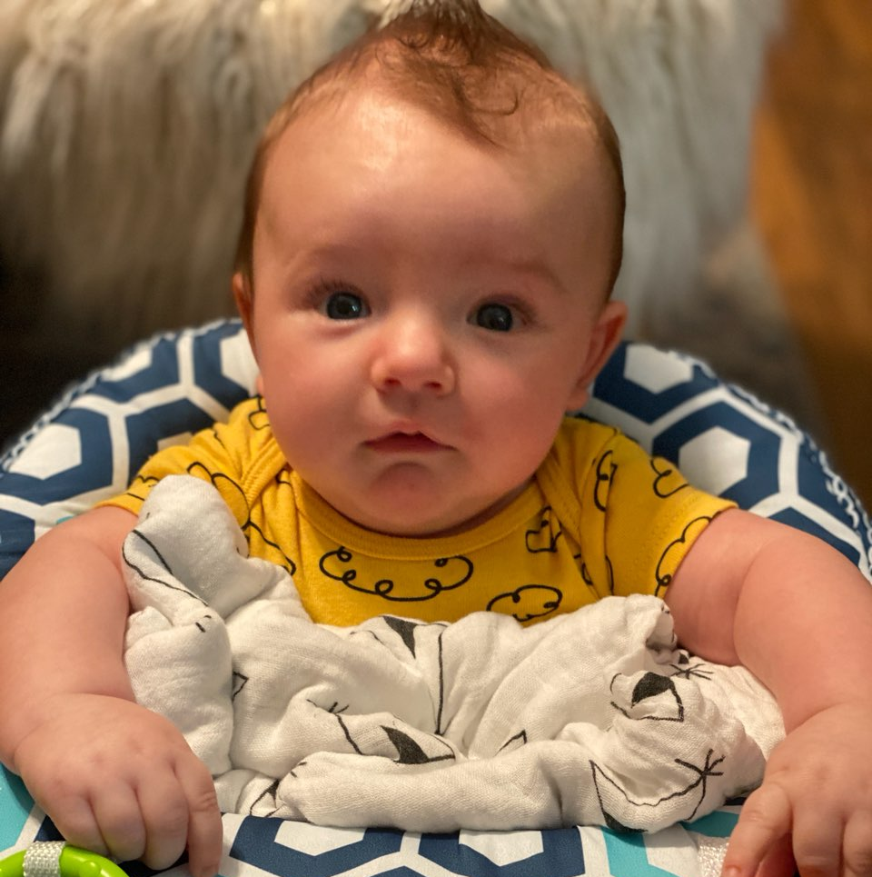
Here Noah is finding out that the coronavirus is spiking again...

Slide 7
Prayer and Announcements
Sunday: 9:15 Fellowship
9:30 SS Master Class
10:30 Worship
Revelation Study available on our church website
www.faithprinceton.org
Email questions and comments to
pastor@faithprinceton.org

Slide 9
Letters to the Seven Churches – Revelation 2-3
(Cont.)

Slide 10
1:4
the seven churches that are in Asia:

Slide 11
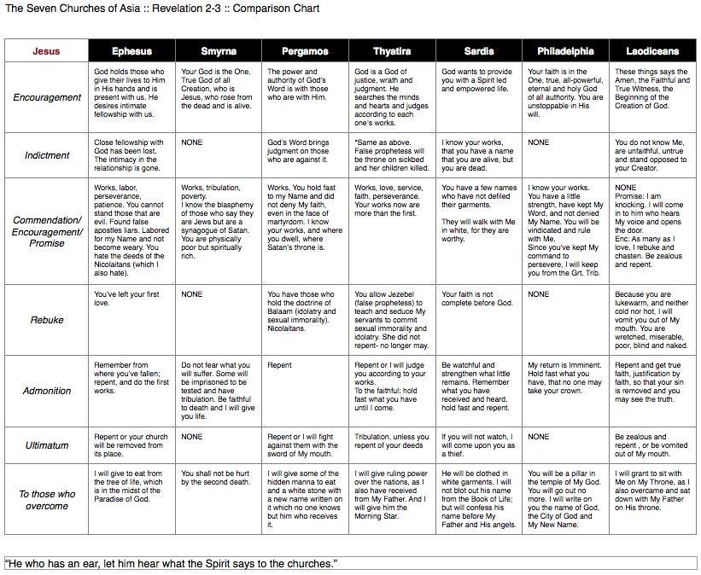
https://ph16.blogspot.com/2012/06/summaries-of-churches-ephesus-off.html?m=1
Notes:
Summaries of the churches: Ephesus: Off. Good doctrine. Had it right, lost first love (fellowship/intimacy). Needs to remember and repent. Smyrna: Right On. Good doctrine. The suffering church. Spiritually rich. Stay faithful to the end. Pergamos: Off. Bad doctrine. Living in sin. Needs to repent, build on the Word of God. Thyatira: Off. Bad doctrine. Living in sin. Needs to repent, build on the word of God. Sardis: Off. Bad doctrine. Living in the flesh. Spiritually dead. Repent and yield to the Spirit. Philadelphia: Right On. Good doctrine. Spirit filled and led. In the will of God. Keeping God’s Word. Hold fast. Laodiceans: Off. Bad doctrine. False/apostate church. Spiritually dead, in the flesh. Repent and receive Jesus.

Slide 12
Ephesus – Revelation 2:1-7
Message:
Remember the heights
Repent of the fall
Re-do the things you did at first
Notes:
Tyndale Commentary
The Greek imperative is present, with a meaning like ‘keep on remembering’, ‘hold in memory’. They had enjoyed a close walk with God. Let their minds dwell on that. The second step is repent (the aorist points to a sharp break with evil). Christians can never dally with wrong. There must be a sharp break with it. But Christianity is not basically negative and the third step is do the things you did at first, i.e. the works that had issued from their first love.
EPHESIANS 3:14-21
For this reason I bow my knees before the Father, from whom every family in heaven and on earth derives its name, that He would grant you, according to the riches of His glory, to be strengthened with power through His Spirit in the inner man, so that Christ may dwell in your hearts through faith; and that you, being rooted and grounded in love, may be able to comprehend with all the saints what is the breadth and length and height and depth, and to know the love of Christ which surpasses knowledge, that you may be filled up to all the fullness of God. Now to Him who is able to do far more abundantly beyond all that we ask or think, according to the power that works within us, to Him be the glory in the church and in Christ Jesus to all generations forever and ever. Amen.
Ephesians 3:14‭-‬21 NASB
https://bible.com/bible/100/eph.3.14-21.NASB

Slide 13
Smyrna – Revelation 2:8-11
Message
Don’t be afraid
Be faithful until death
Notes:
Smyrna
Center of the Emperor cult. Forced to say “Ceasar is Lord.”
Polycarp, Bishop of Smyrna, given choice to renounce Christ or die… “Eighty and six years have I served Him (Christ), and He has done me no wrong. How can I blaspheme my King who saved me?”
Martyred: Feb 23, AD 155.

Slide 14
Pergamum – Revelation 2:12-17
Message
Don’t mix Truth with error
Repent of immorality and idolatry
Expect the soon return of Jesus
Notes:
New Name
This must be understood in the light of ideas held in antiquity about the function of a name. With us a name is no more than a distinguishing mark, a label. But in antiquity the name was widely held to sum up what the man stood for. It represented his character. It stood for the whole man. Here then the new name represents a new character. The fact that no-one knows it would be a crippling disadvantage for us. In the modern world what is the use of a name that nobody knows? But for people of antiquity the hidden name was precious. It meant that God had given the overcomer a new character which no-one knew except himself. It was not public property. It was a little secret between him and his God.

Slide 15
Thyatira – Revelation 2:18-29
Message
Be careful who you listen to.
Repent.
Hold fast to the Truth.

Slide 16
Sardis – Revelation 3:1-6
Message
A good reputation means nothing without inner Spiritual life
We need to wake up and work for the Lord’s Kingdom until He comes
Your spiritual life is not judged by the activities or spirituality of those around you
Notes:
We need to lay down our “rights” and pick up “the Kingdom.”

Slide 17
Philadelphia – Revelation 3:7-13
Message
“Little is much when God is in it…”
God is in control of all opportunities.
We need to trust God’s power, keep His Word, and never deny His Name.
God protects those who are His.
Notes:
Little Is Much When God Is In It Songwriters: Kreiger Conrad / Kreiger Donna / Suffield F W Mrs
© Word Music Llc, Word Music, Llc
In the harvest field now ripened There's a work for all to do; Hark! the Master's voice is calling, To the harvest calling you.
Does the place you're called to labor Seem so small and little known? It is great if God is in it, And He'll not forget His own.
Little is much when God is in it! Labor not for wealth or fame; There's a crown, and you can win it, If you go in Jesus' name.
When the conflict here is ended And our race on earth is run, He will say, if we are faithful, "Welcome home, My child—well done!“
In the mad rush of the broad way, In the hurry and the strife, Tell of Jesus' love and mercy, Give to them the Word of Life.
Are you laid aside from service, Body worn from toil and care? You can still be in the battle, In the sacred place of prayer.

Slide 18
Laodicea – Revelation 3:14-22
Message:
Don’t depend on your own wealth or treasure things of earth
Be on fire for the Lord and useful to Him
Fellowship with Jesus by responding to His call (He is constantly knocking on the door)

Slide 19
Prayer for the Churches

Slide 20
Revelation 4 – A Glimpse into Heaven

Slide 21
Revelation 4:1-4
1 After these things I looked, and behold, a door standing open in heaven, and the first voice which I had heard, like the sound of a trumpet speaking with me, said, “Come up here, and I will show you what must take place after these things.” 2 Immediately I was in the Spirit; and behold, a throne was standing in heaven, and One sitting on the throne. 3 And He who was sitting was like a jasper stone and a sardius in appearance; and there was a rainbow around the throne, like an emerald in appearance. 4 Around the throne were twenty-four thrones; and upon the thrones I saw twenty-four elders sitting, clothed in white garments, and golden crowns on their heads.

Slide 22
Revelation 4:5-7
5 Out from the throne come flashes of lightning and sounds and peals of thunder. And there were seven lamps of fire burning before the throne, which are the seven Spirits of God; 6 and before the throne there was something like a sea of glass, like crystal; and in the center and around the throne, four living creatures full of eyes in front and behind. 7 The first creature was like a lion, and the second creature like a calf, and the third creature had a face like that of a man, and the fourth creature was like a flying eagle.

Slide 23
Revelation 4:8
8 And the four living creatures, each one of them having six wings, are full of eyes around and within; and day and night they do not cease to say,
“Holy, holy, holy is the Lord God, the Almighty, who was and who is and who is to come.”

Slide 24
Revelation 4:9-11
9 And when the living creatures give glory and honor and thanks to Him who sits on the throne, to Him who lives forever and ever, 10 the twenty-four elders will fall down before Him who sits on the throne, and will worship Him who lives forever and ever, and will cast their crowns before the throne, saying,
11 “Worthy are You, our Lord and our God, to receive glory and honor and power; for You created all things, and because of Your will they existed, and were created.”

Slide 25
Revelation 4 – A Glimpse into Heaven

Slide 26
Revelation 4 – A Glimpse into Heaven
“The great throne room vision of chapter 4 serves to remind believers living in the shadow of impending persecution that an omnipotent and omniscient God is still in control.”
Newport, The Lion and the Lamb, p. 168

Slide 27
Revelation 4:1
1 After these things I looked = introduces new vision
and behold, a door standing open in heaven,
and the first voice which I had heard, like the sound of a trumpet speaking with me, said, “Come up here, and I will show you what must take place after these things.”
Not pre-tribulation rapture of the church (singular verb)
“Must” = moral necessity; “behooves; necessary; inevitable”
Notes:
4:1
formula introduces new vision (see 7:1, 9; 15:5; 18:1; 19:1)
John fond of “doors”
Heaven is singular in John all but one time. (Can mean place God resides, sky, spiritual battleground, etc)
First voice = Jesus (Rev 1:10ff) Alpha and Omega
“Come up here” = not pre-tribulation rapture (singular verb); rather a glimpse of what was happening in heaven and what MUST happen in the future!
AND WILL happen in the future! Jesus knows what He is talking about!!!

Slide 28
Revelation 4:2-3
2 Immediately I was in the Spirit = just like in chapter 1:10
and behold, a throne was standing in heaven
John uses the word “throne” 47 times out of 62 in the NT.
Matthew is next highest with just 5 uses.
“John will not let them forget that there is a throne above every throne.” (Morris, Tyndale)
and One sitting on the throne. 3 And He who was sitting was like a jasper stone and a sardius in appearance; and there was a rainbow around the throne, like an emerald in appearance = ONE on the throne = it’s NOT you or me!!!
Notes:
Description of the ONE:
brilliance, radiance
Jasper and sardius = to High Priest’s breastplate? See Exodus 39:8-14 NKJV
8 And he made the breastplate, artistically woven like the workmanship of the ephod, of gold, blue, purple, and scarlet thread, and of fine woven linen. 9 They made the breastplate square by doubling it; a span was its length and a span its width when doubled. 10 And they set in it four rows of stones: a row with a sardius, (other translations: carnelian, ruby) a topaz, and an emerald was the first row; 11 the second row, a turquoise, a sapphire, and a diamond; 12 the third row, a jacinth, an agate, and an amethyst; 13 the fourth row, a beryl, an onyx, and a jasper (other translations: emerald [NIV], white moonstone [NLT], diamond, crystal). They were enclosed in settings of gold in their mountings. 14 There were twelve stones according to the names of the sons of Israel: according to their names, engraved like a signet, each one with its own name according to the twelve tribes.
(These two are the first and last stones... Probably engraved with Reuben and Benjamin, the first and last of the sons of Israel, representative of all twelve).
Rainbow: sign of eternal covenant
Similar description of God’s Throne in Ezekiel 1:26-28 NLT
26 Above this surface was something that looked like a throne made of blue lapis lazuli. And on this throne high above was a figure whose appearance resembled a man. 27 From what appeared to be his waist up, he looked like gleaming amber, flickering like a fire. And from his waist down, he looked like a burning flame, shining with splendor. 28 All around him was a glowing halo, like a rainbow shining in the clouds on a rainy day. This is what the glory of the Lord looked like to me. When I saw it, I fell face down on the ground, and I heard someone’s voice speaking to me.

Slide 29
Revelation 4:4
4 Around the throne were twenty-four thrones; and upon the thrones I saw twenty-four elders sitting, clothed in white garments, and golden crowns on their heads.
24 thrones = representative of fullness of God’s people? [cf. Rev 5:9-10 the song of the redeemed]
12 patriarchs and 12 apostles
Revelation 21:12-14 = 12 tribes listed on the gates and 12 apostles on the foundation
White garments = purity and victory
Notes:
vs. 4 Leon Morris, Tyndale
Some argue that the number twenty-four is to be seen as the sum of the twelve patriarchs of the Old Testament and the twelve apostles of the New, who are thus seen to form a unity. The song of Moses and of the Lamb are indeed one (15:3). And, while the names of the twelve tribes are on the gates of the New Jerusalem, those of the apostles are on its foundations (21:12, 14). It is objected that their song (5:9–10) differentiates them from the redeemed (so Mounce), and that in any case the redeemed do not sit on thrones until the final consummation.
Revelation 21:10-14
10 So he took me in the Spirit to a great, high mountain, and he showed me the holy city, Jerusalem, descending out of heaven from God. 11 It shone with the glory of God and sparkled like a precious stone—like jasper as clear as crystal. 12 The city wall was broad and high, with twelve gates guarded by twelve angels. And the names of the twelve tribes of Israel were written on the gates. 13 There were three gates on each side—east, north, south, and west. 14 The wall of the city had twelve foundation stones, and on them were written the names of the twelve apostles of the Lamb.
...this view the elders represent the worship of heaven of which that on earth is at best a copy. Best is probably the view of Charles; the elders are angelic beings indeed, but angelic beings who are ‘the heavenly representatives of the whole body of the faithful’. The thrones point to royal state and white is the colour of triumph. The crowns of gold also emphasize the high estate of these exalted beings (the Greek stephanos usually denotes a wreath of victory or festivity rather than a royal crown: see note on 2:10; but here we must take the crowns in conjunction with the thrones).

